Slide 1

Introduction to Revolutionizing Potato Farming
Revolutionizing Potato Farming
Discover how cutting-edge AI technology is transforming the age-old practice of potato farming. Unlock new levels of efficiency, productivity, and sustainability to feed a growing world.

Slide 2
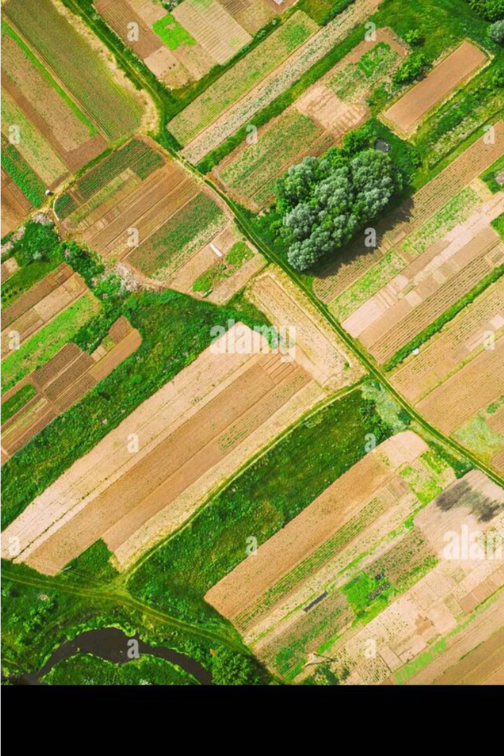
Introduction to Revolutionizing Potato Farming
Discover how cutting-edge AI technology is transforming the age-old practice of potato farming. Unlock new levels of efficiency, productivity, and sustainability to feed a growing world.

Slide 3
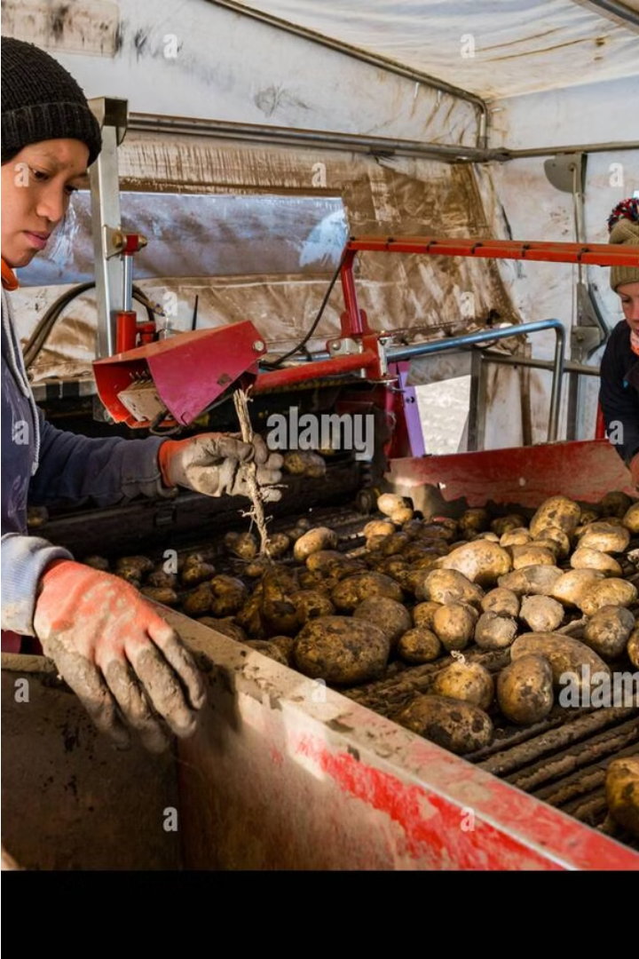
The Current State of Potato Farming
Traditional farming methods still dominate the industry, with manual labor and outdated equipment remaining the norm in many regions
Farmers often struggle with issues like unpredictable weather, pests and diseases, and soil depletion, leading to inconsistent yields and profits
Lack of access to advanced technologies and data-driven insights hinders the ability to optimize operations and adapt to changing market demands

Slide 4
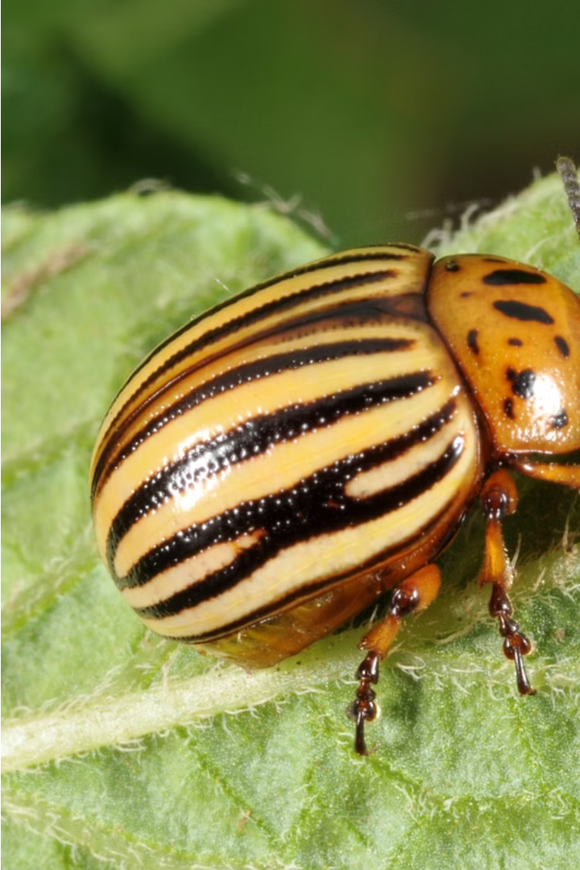
Challenges in Traditional Potato Farming
Susceptibility to pests and diseases that can devastate crops, requiring heavy use of pesticides
Reliance on manual labor-intensive processes like planting, harvesting, and sorting, leading to high labor costs
Difficulties in adapting to climate change and unpredictable weather patterns that impact yield and quality

Slide 5
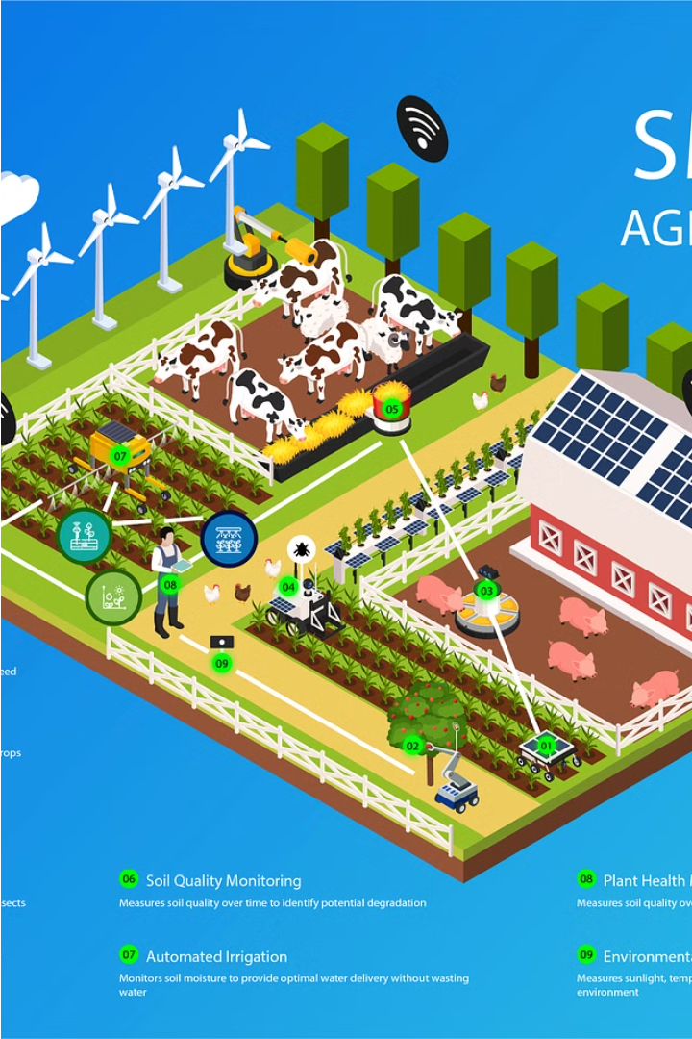
Proposed AI-Powered Solution
Leveraging cutting-edge artificial intelligence, our revolutionary solution empowers potato farmers to optimize their operations and overcome longstanding challenges. By integrating smart sensors, predictive analytics, and autonomous systems, we enable data-driven decision-making for enhanced productivity and sustainability.
Through precision farming techniques, AI-powered disease and pest monitoring, and real-time weather forecasting, our platform equips farmers with the insights and tools they need to adapt to changing climate conditions and market demands.

Slide 6
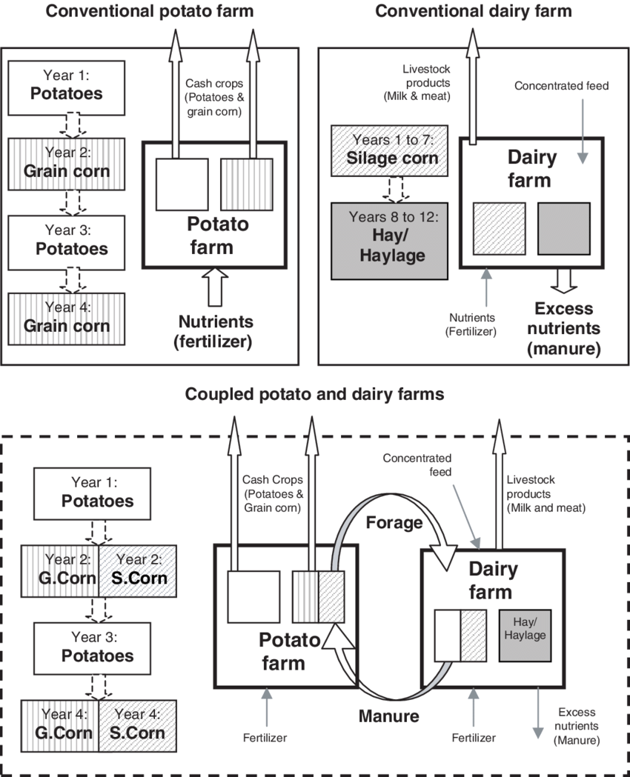
ARCHITECTURE DIAGRAM
Designing software architecture is a key activity in developing
software-intensive systems.
In fact, every software-intensive system has a software architecture, whether it is complex or simple.
A software architecture describes the components of a system, interactions among components, and the interaction of a system as a whole with its environment (Tekinerdogan, 2014).
A software architecture is an abstract representation that identifies the higher-level structure of a system and is important for supporting communication among stakeholders, for guiding design decisions, for supporting the subsequent development process, and for analysis of an overall system

Slide 7
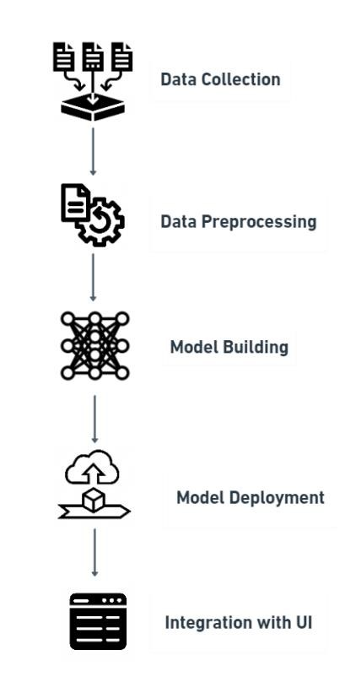
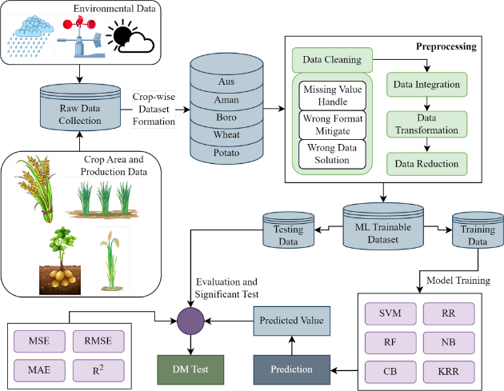
ARCHITECTURE DIAGRAM

Slide 8
Key Components of the AI System
Sensor Network
Predictive Analytics
A dense network of smart sensors across the farm, monitoring soil, weather, pests, and plant health in real-time.
Advanced machine learning models that analyze sensor data to forecast crop yields, detect diseases, and anticipate weather patterns.
Autonomous Systems
Farmer-Friendly Interface
Robotic and autonomous equipment that can automate tasks like planting, harvesting, and targeted spraying based on AI insights.
An intuitive dashboard that presents insights and recommendations to help farmers make informed, data-driven decisions.

Slide 9
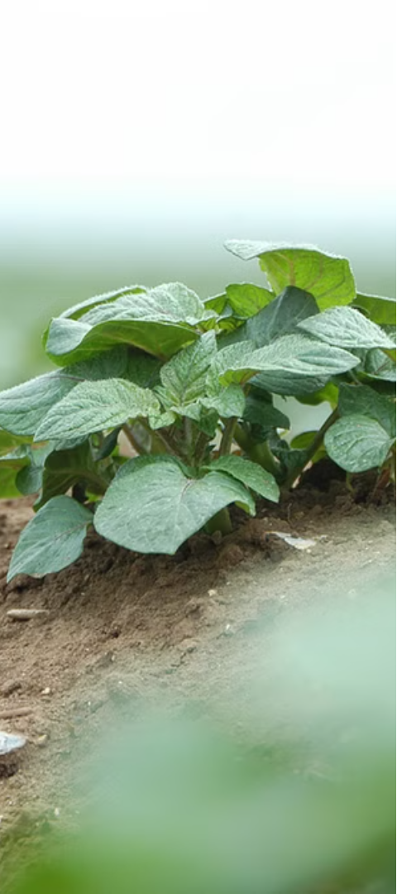
Methodology: Data Collection and Preprocessing
1
Sensor Integration
Deploy a network of smart sensors across the potato fields to capture real-time data on soil conditions, weather patterns, pest activity, and plant health.
2
Satellite Imagery
Leverage high-resolution satellite imagery to monitor crop growth, detect anomalies, and track changes in the farm's topography over time.
3
Data Cleansing
Implement robust data cleansing protocols to identify and address any inconsistencies, outliers, or missing values in the sensor and imagery data.

Slide 10
Methodology: Machine Learning Model Development
With the sensor data and satellite imagery collected and preprocessed, we leverage advanced machine learning techniques to develop predictive models for optimizing potato farming operations.
Train neural networks to detect early signs of pests and diseases from sensor data and imagery.
Develop regression models to forecast crop yields based on environmental conditions and historical trends.
Employ deep learning algorithms to classify soil quality and recommend optimal planting strategies.

Slide 11
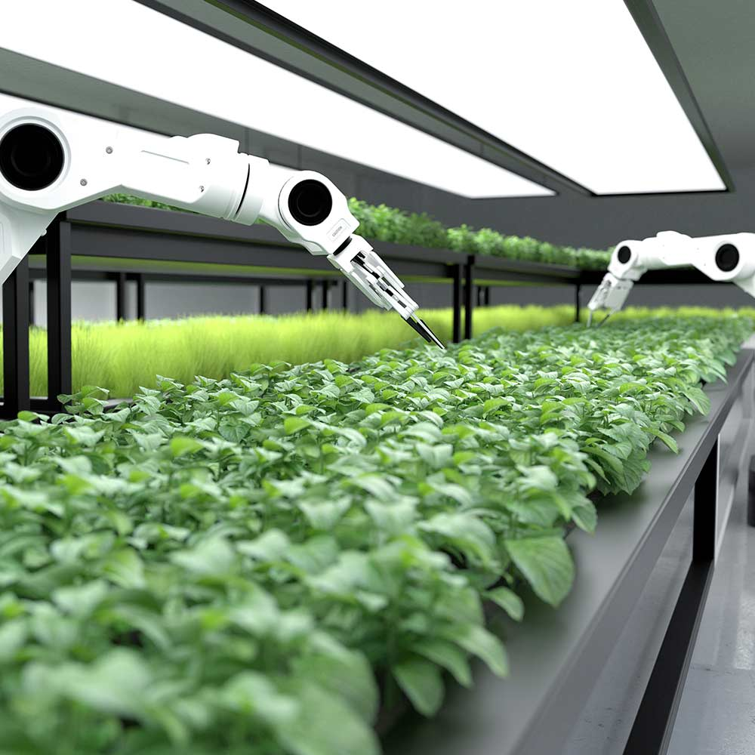



Methodology: Deployment and Integration
Pilot Testing
Deploy the AI system in a controlled pilot environment to validate performance and gather feedback from early adopter farmers.
Scalable Infrastructure
Develop a scalable cloud-based architecture to seamlessly manage sensor data, run predictive models, and deliver insights to farmers nationwide.
Farmer Training
Provide comprehensive training programs to help farmers understand and effectively leverage the AI-powered farming platform for maximum benefit.

Slide 12
Potential Benefits and Impact
Increased Productivity
Enhanced Sustainability
Improved Profitability
Empowered Farmers
Our AI-powered solution helps farmers maximize crop yields by optimizing planting, irrigation, and pest management strategies based on real-time data and predictive insights.
By reducing reliance on harmful pesticides and enabling precision farming techniques, our platform promotes environmentally-friendly practices that preserve natural resources for future generations.
Potato farmers can save on input costs, minimize crop losses, and respond more effectively to market demands, leading to higher profits and financial stability.
Our intuitive, user-friendly platform provides farmers with valuable data-driven insights, allowing them to make informed decisions and take a more proactive role in managing their operations.

Slide 13
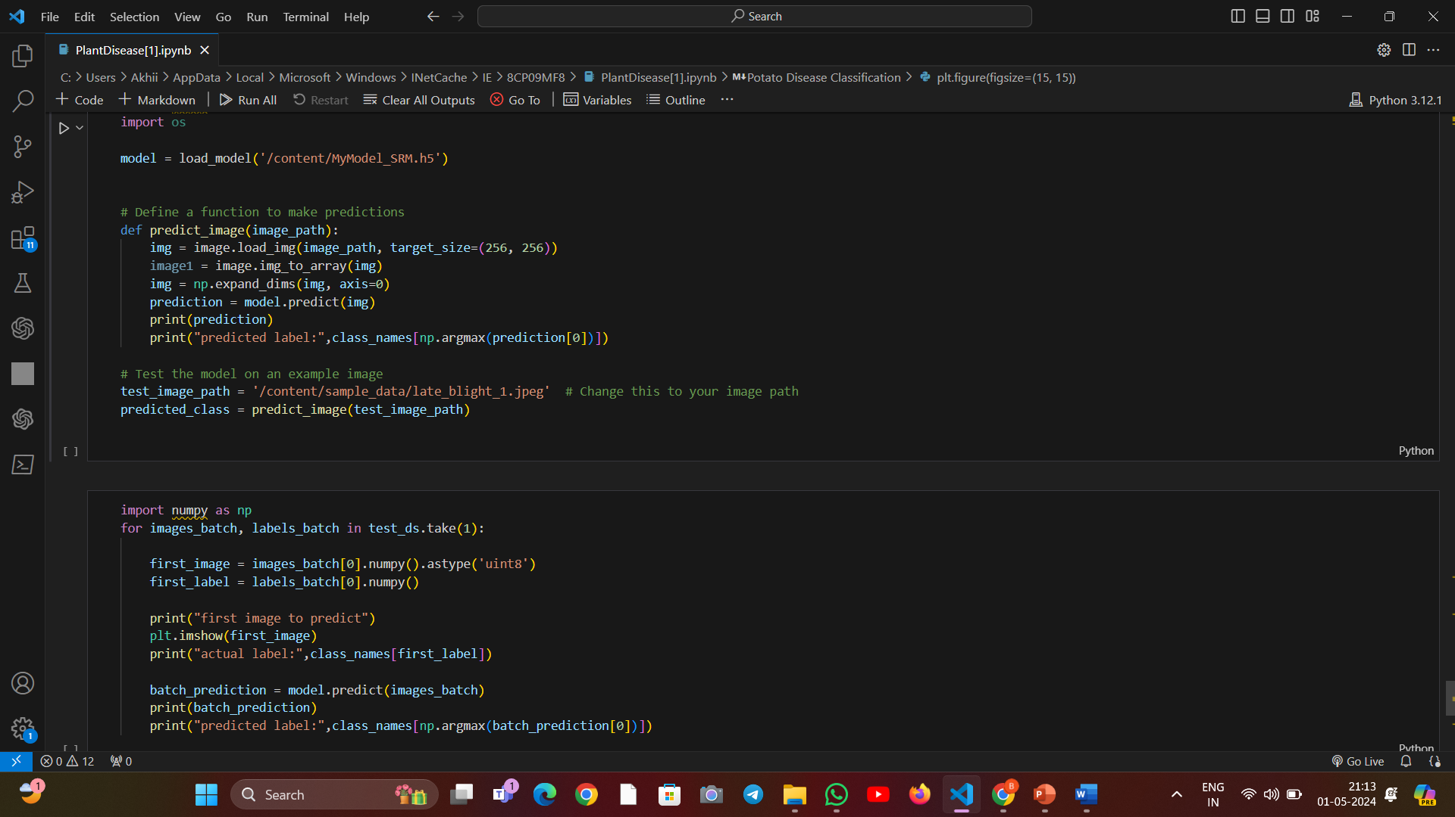
WORKING MODEL WITH CODE AND EXECUTION :

Slide 14
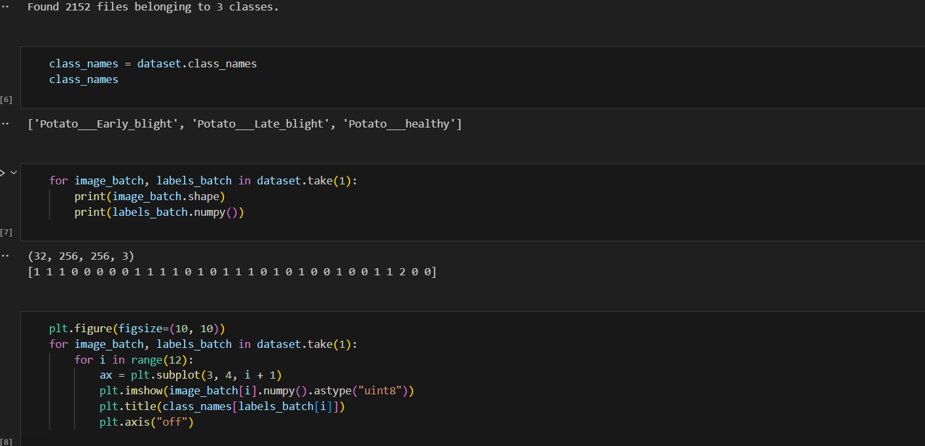

Slide 15
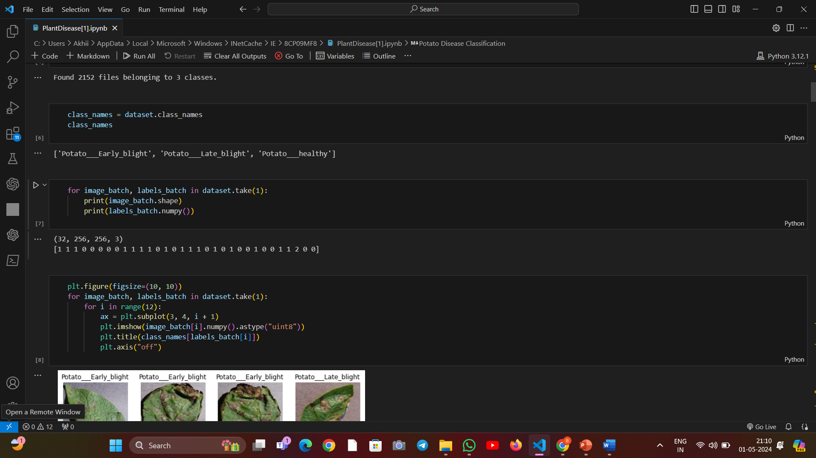

Slide 16
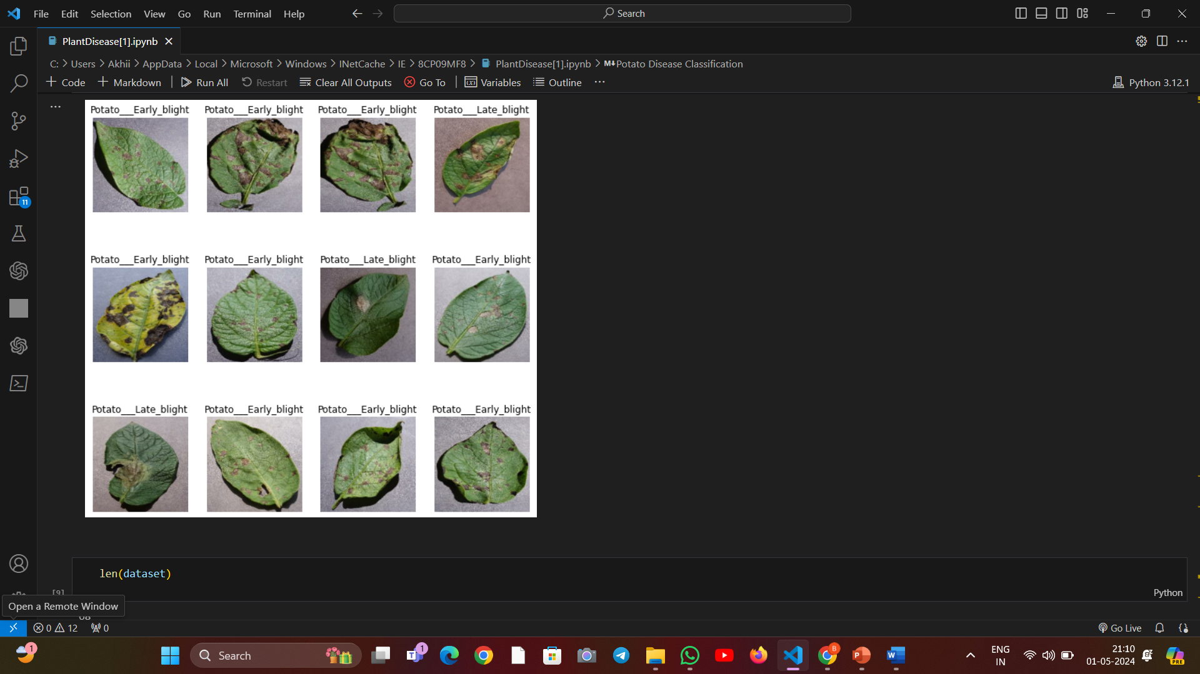

Slide 17
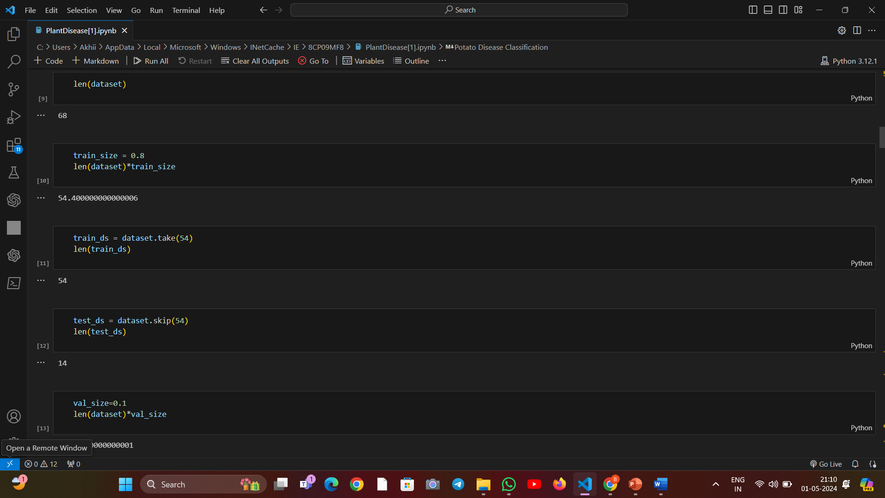

Slide 18
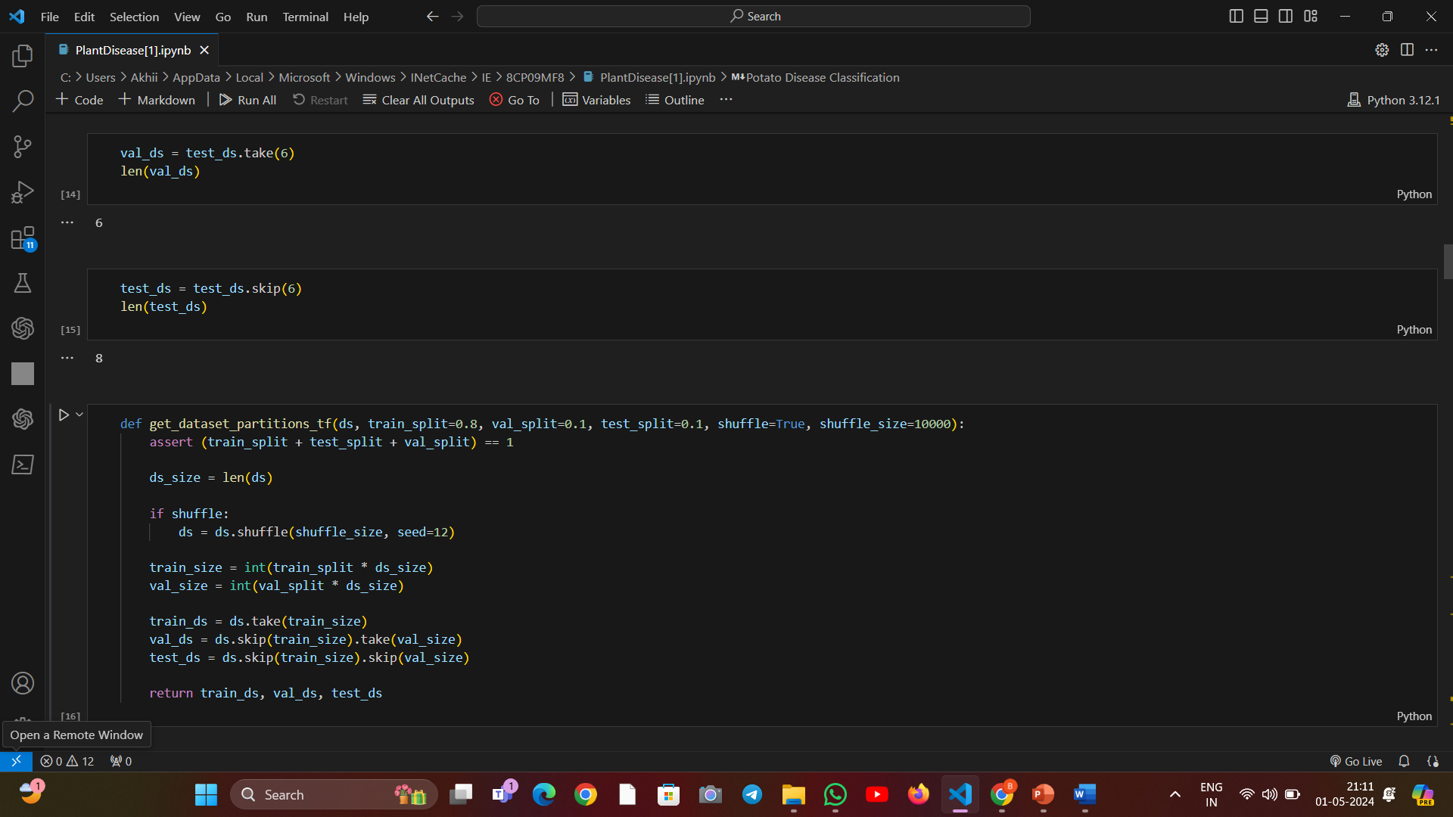

Slide 19
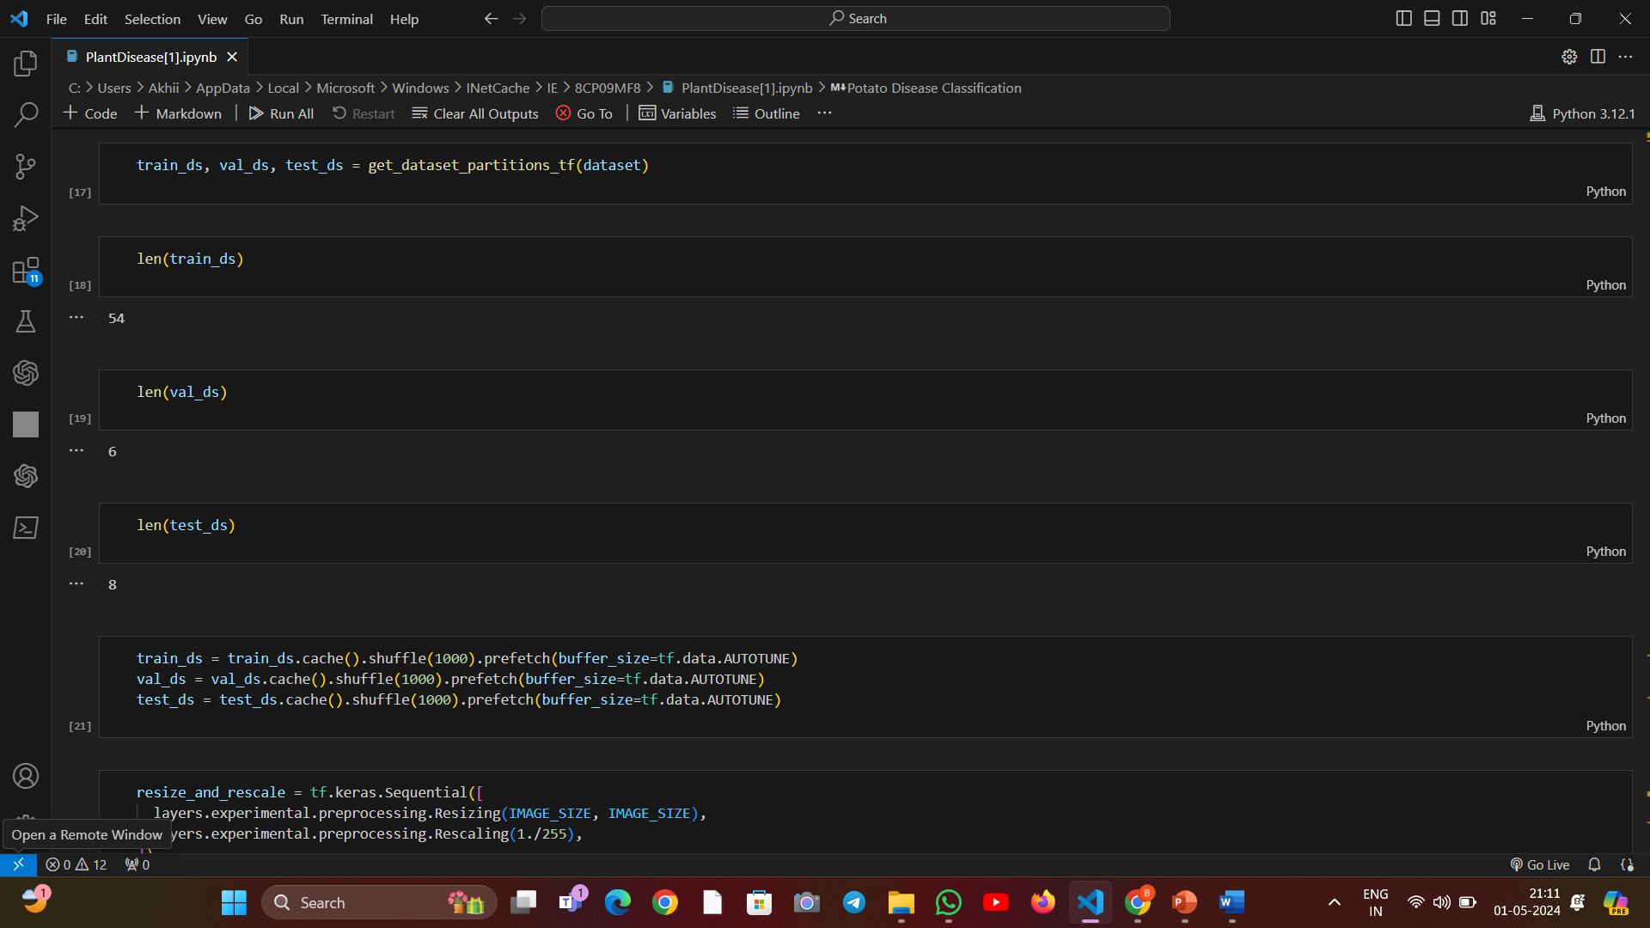

Slide 20
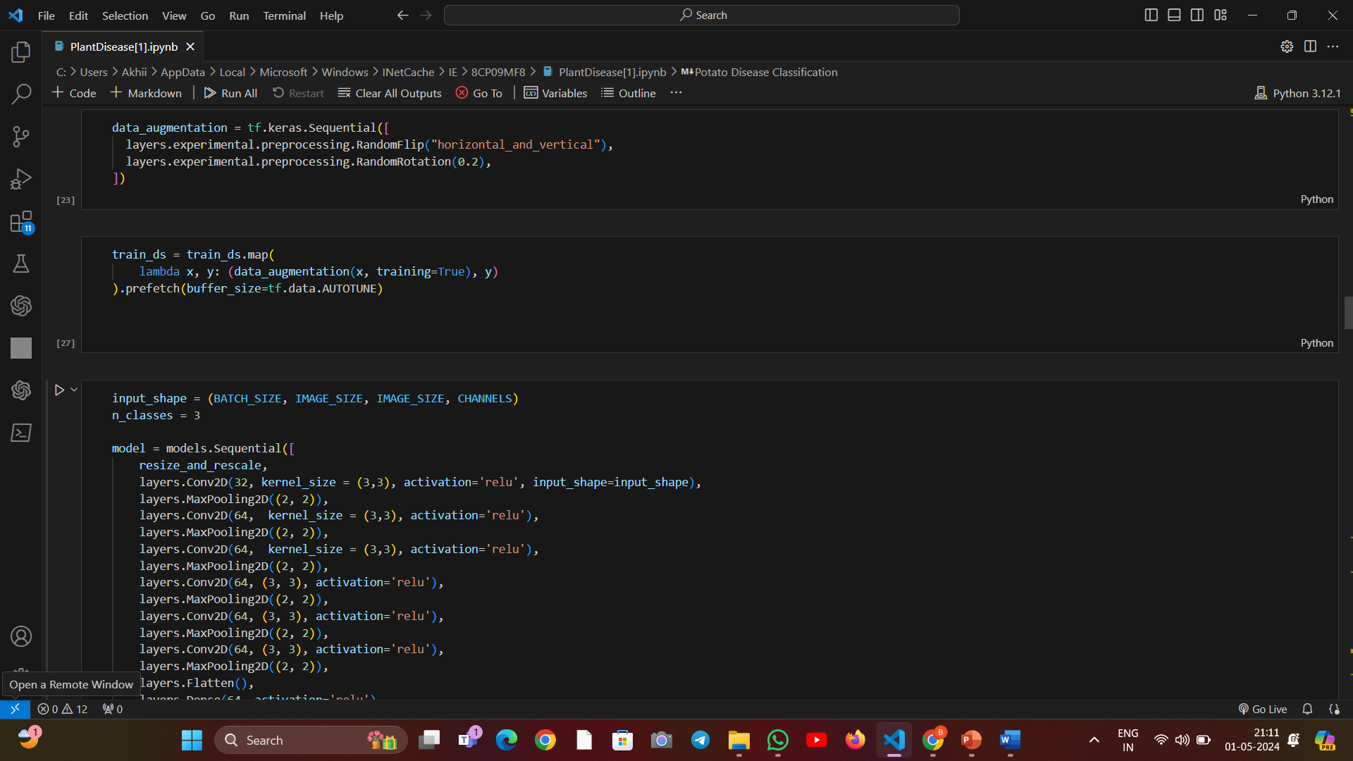

Slide 21
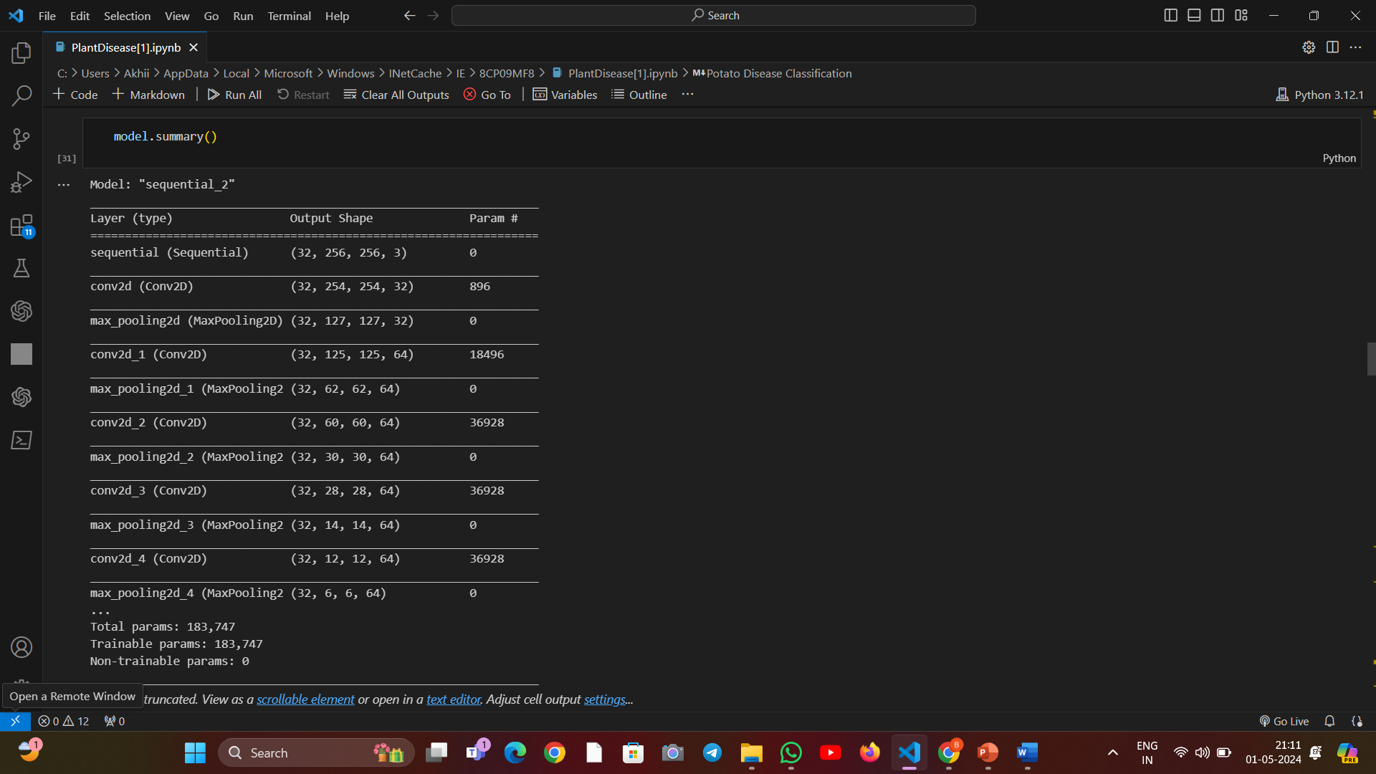

Slide 22
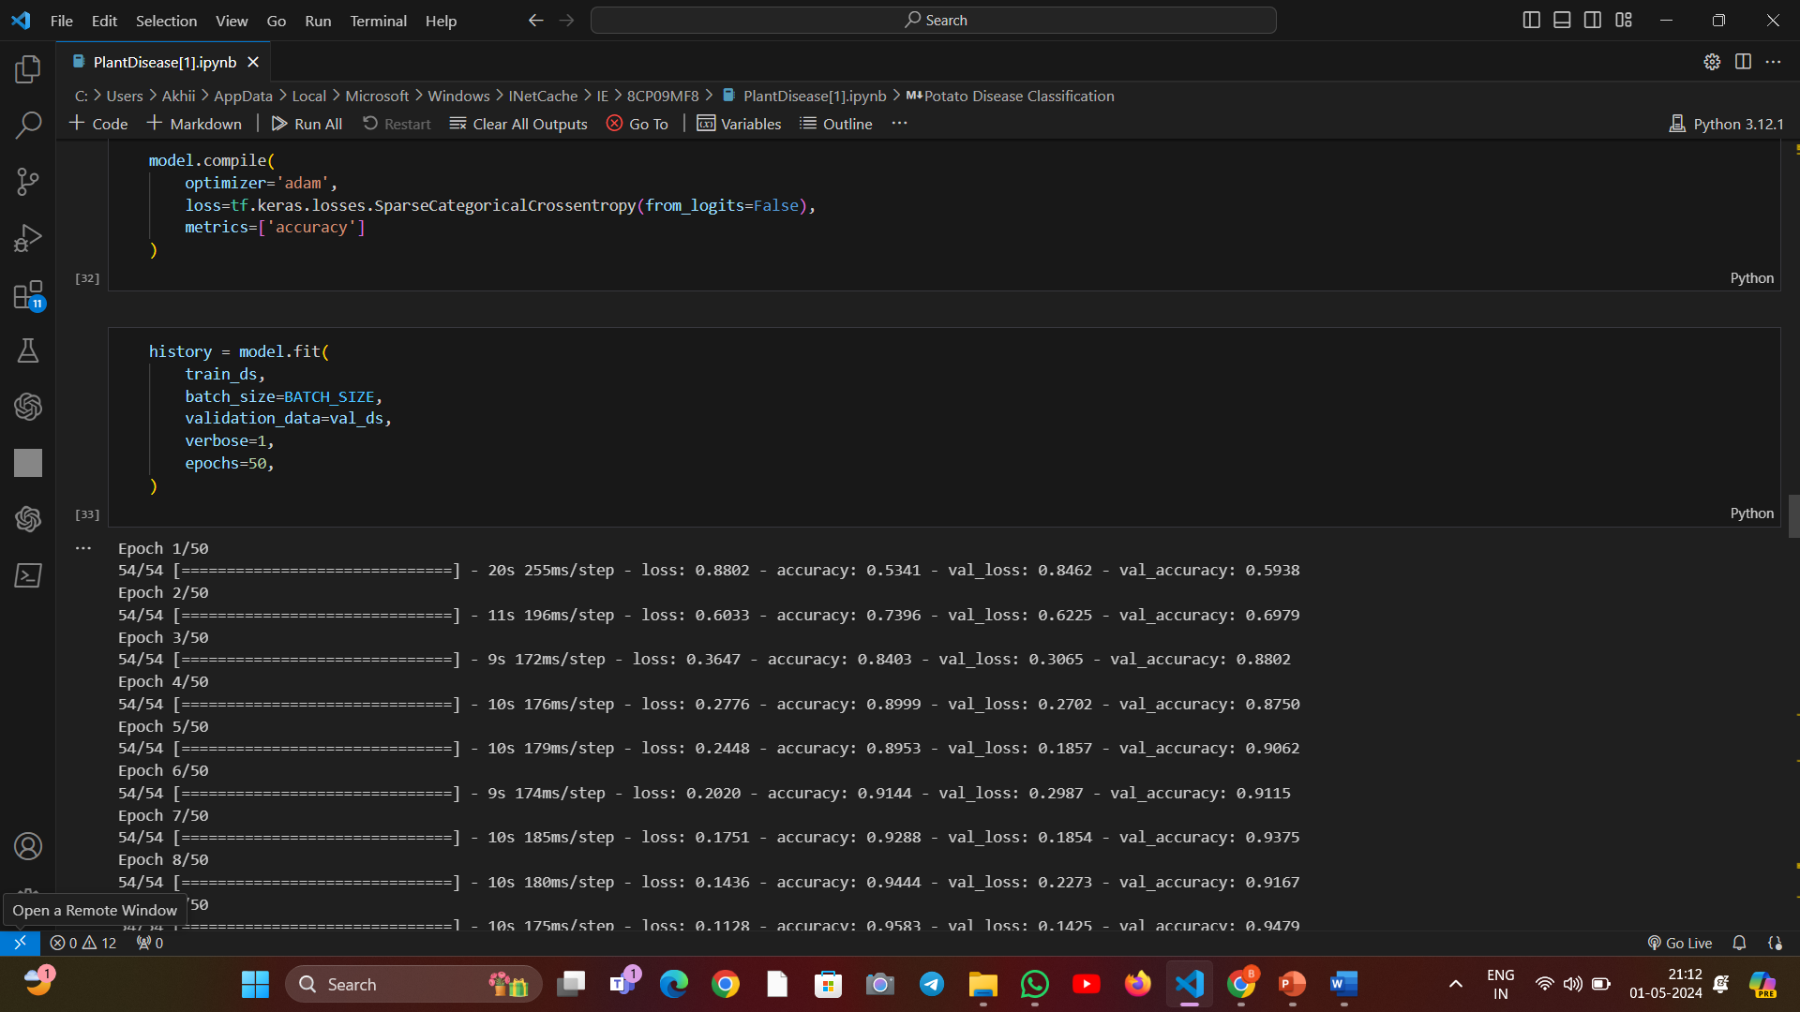

Slide 23
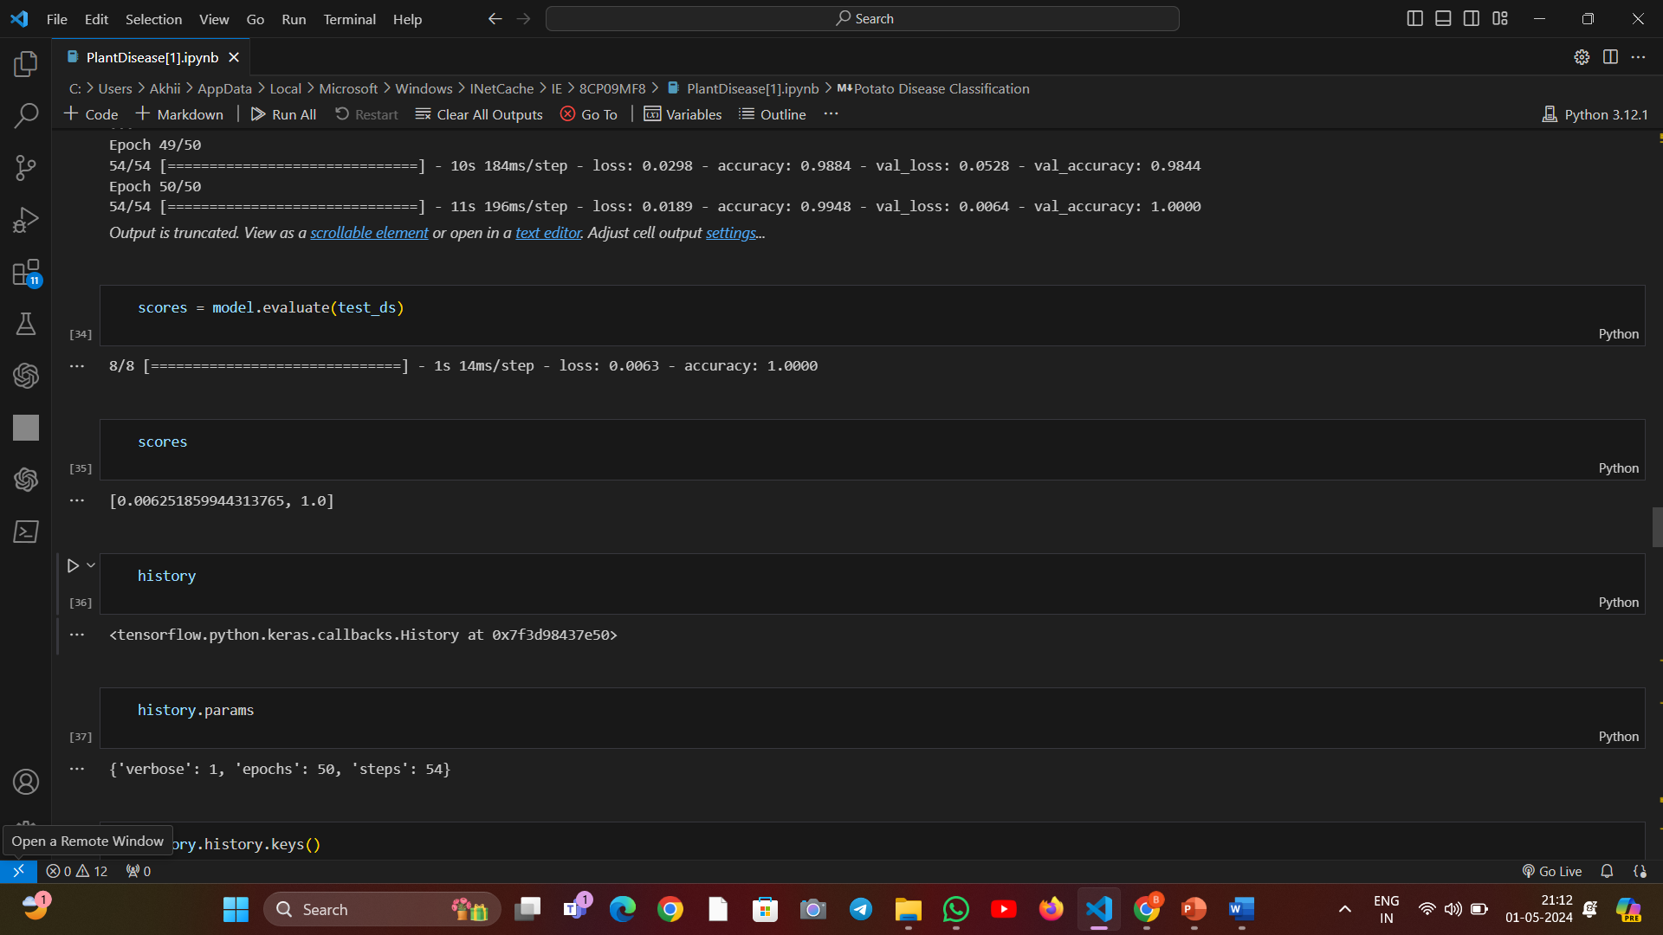

Slide 24
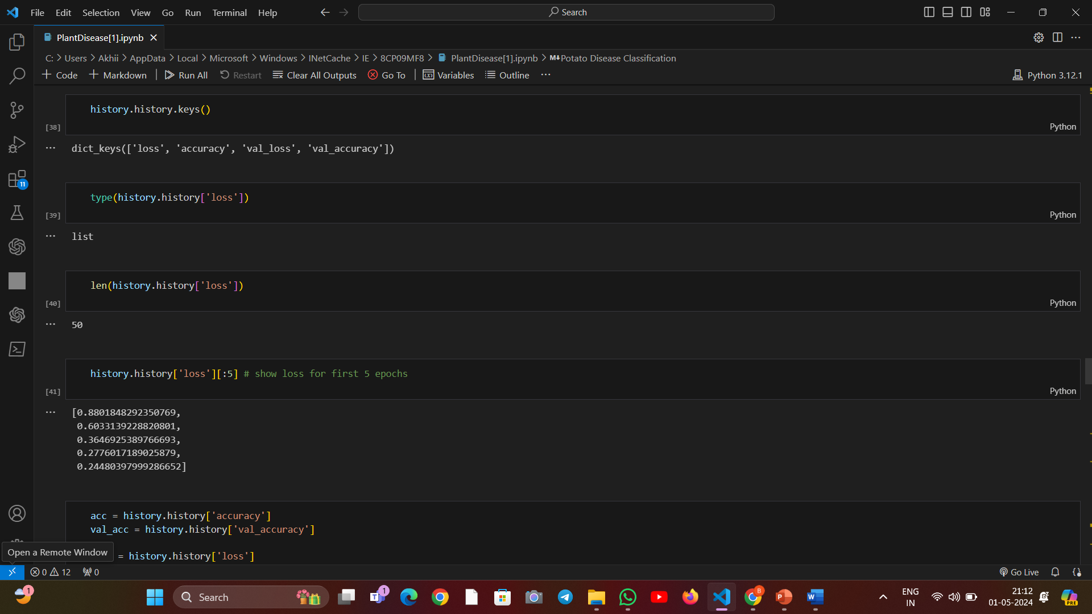

Slide 25
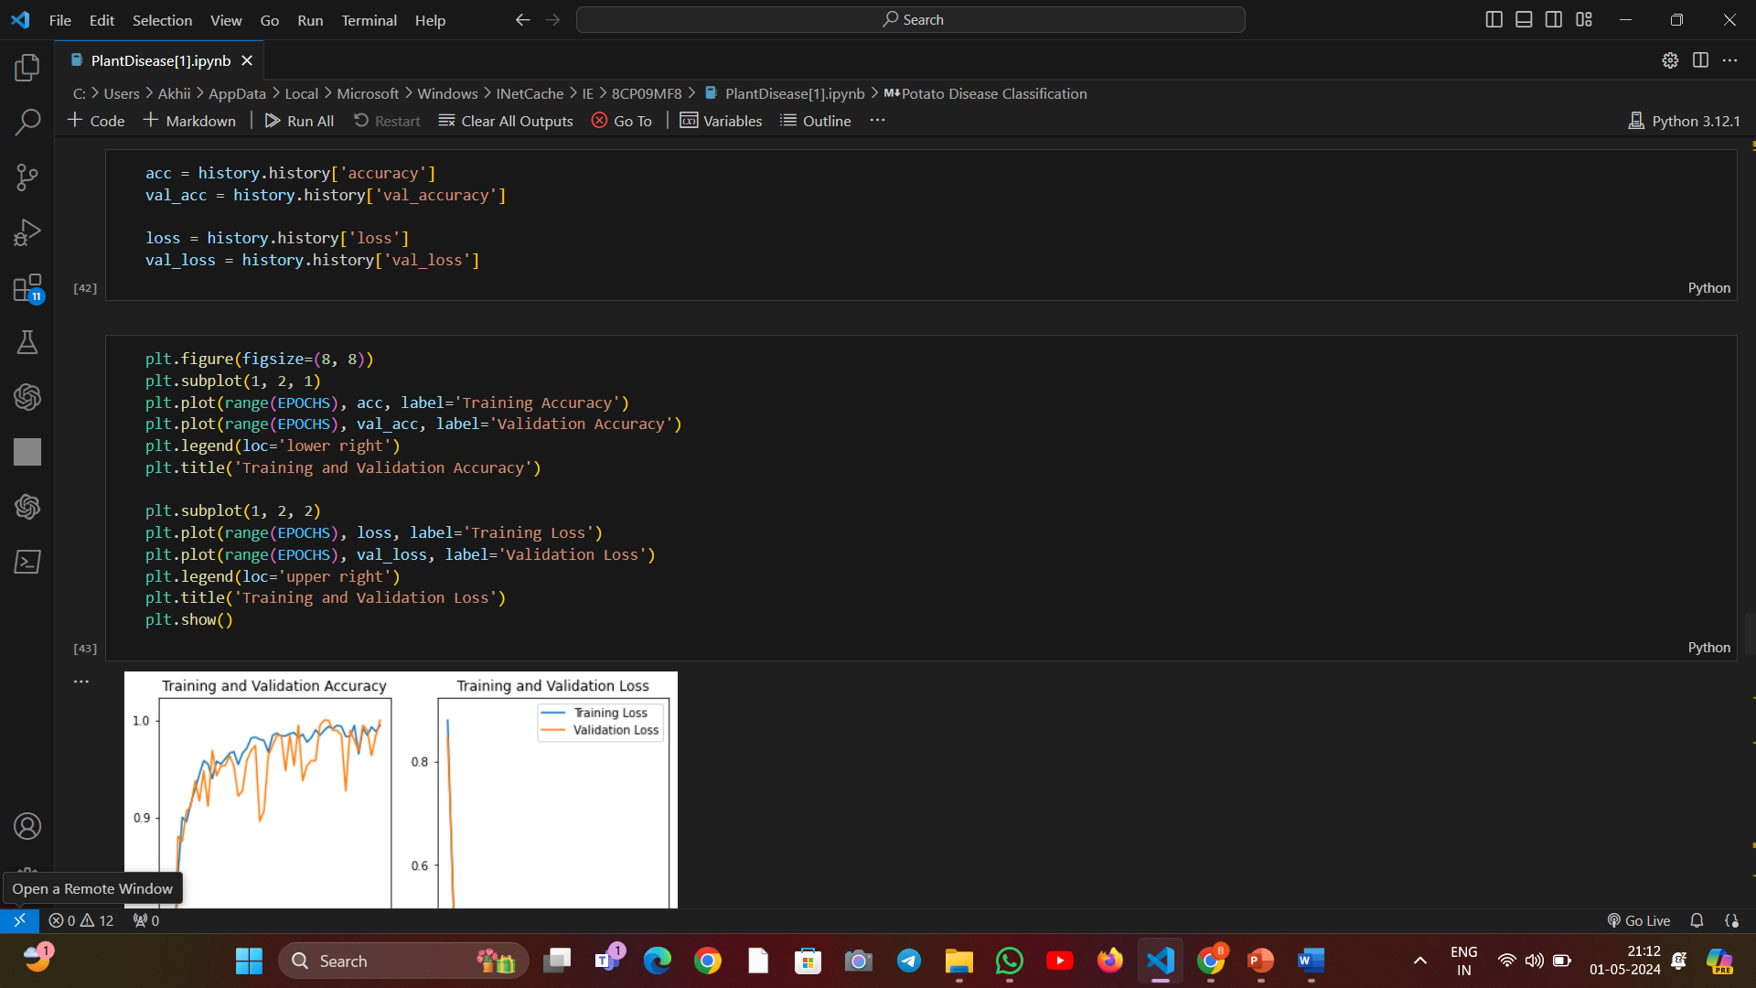

Slide 26
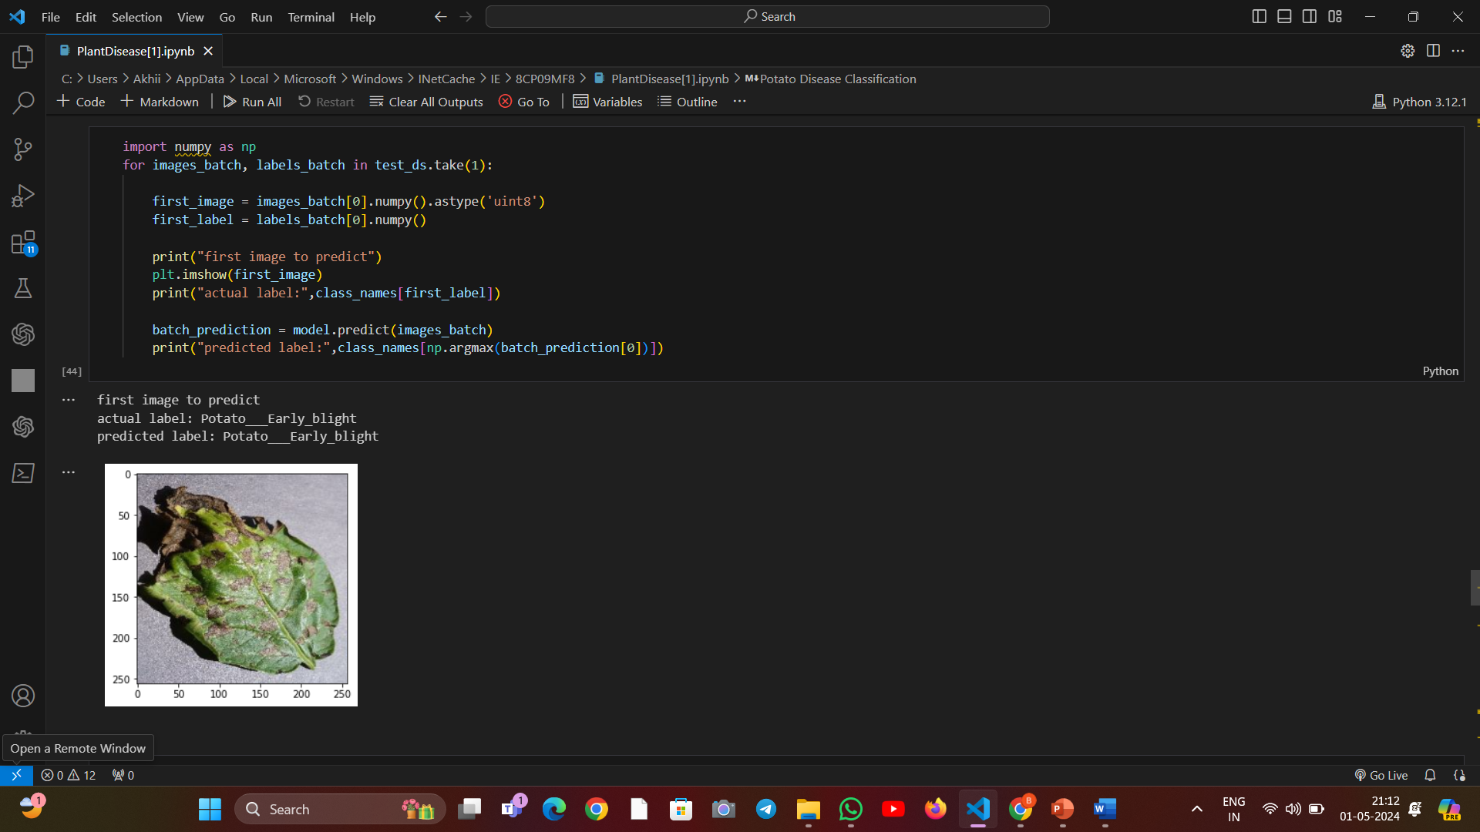

Slide 27
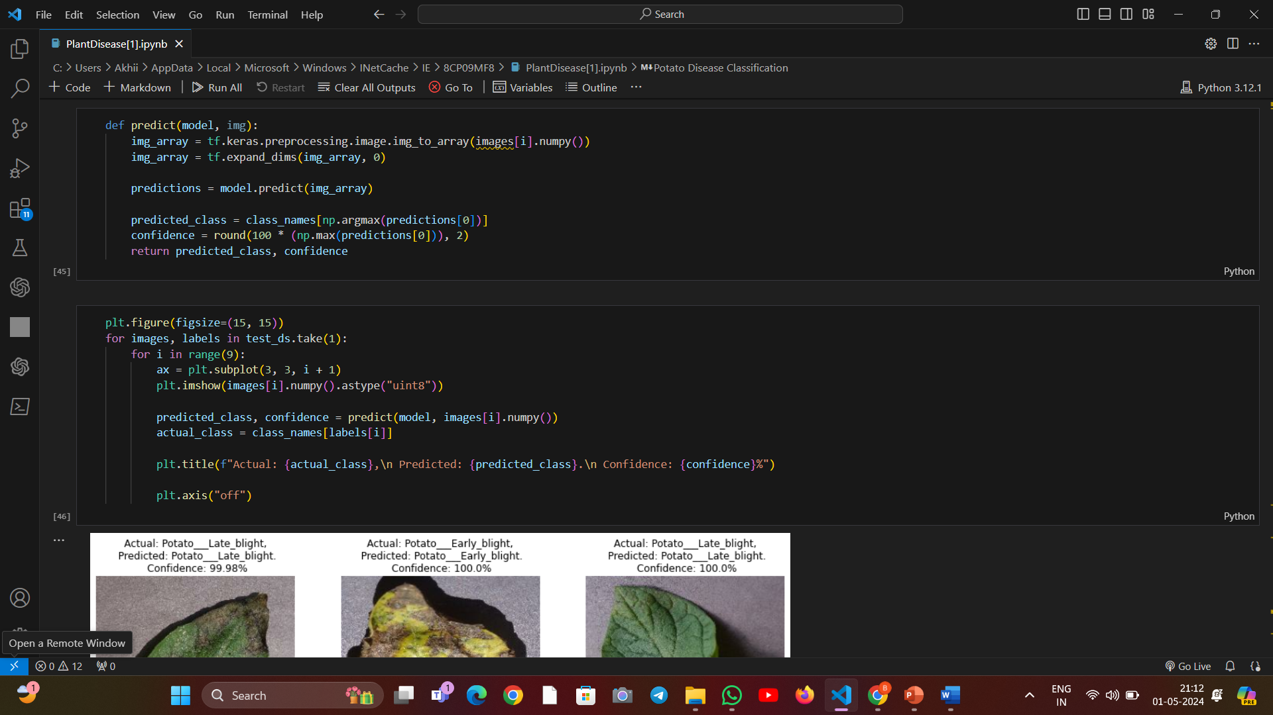

Slide 28
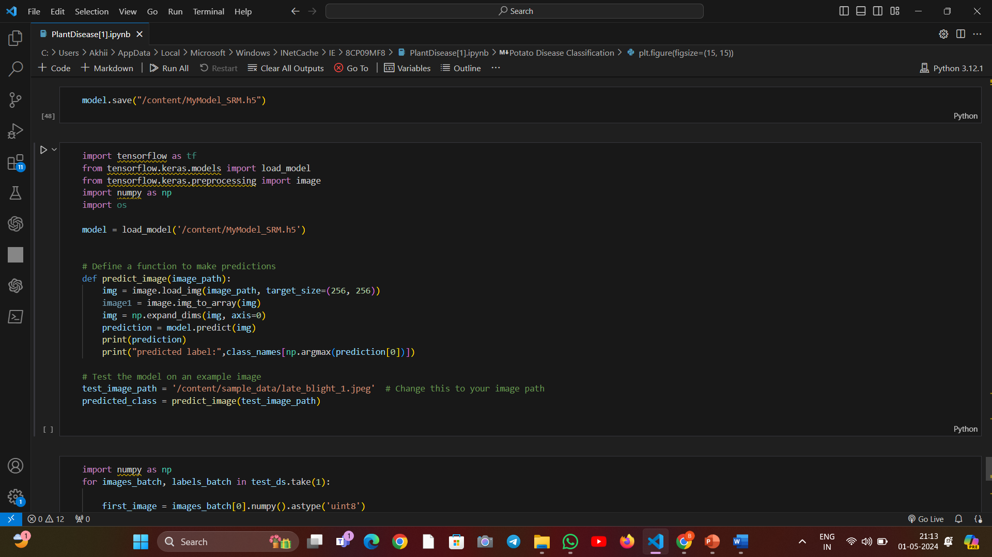

Slide 29


Slide 30
Conclusion and Future Directions
Transformative Impact
Continuous Innovation
Our AI-powered solution for revolutionizing potato farming has the potential to drive a paradigm shift in the industry, boosting productivity, sustainability, and profitability for farmers worldwide.
We remain committed to advancing our technology, incorporating feedback from early adopters, and exploring new frontiers in precision agriculture to stay at the forefront of this rapidly evolving field.
Collaborative Ecosystem
Empowering Farmers
By fostering partnerships with leading research institutions, agricultural organizations, and technology providers, we will continue to expand the capabilities of our platform and deliver even greater value to our customers.
Ultimately, our goal is to empower potato farmers with the data-driven insights and smart tools they need to thrive in an increasingly complex and competitive global market.

Slide 31
Future Enhancements
Predictive Pest and Disease Analytics: Leverage advanced machine learning models to forecast the emergence of pests and diseases, enabling proactive prevention and mitigation strategies.
Autonomous Farming Assistants: Integrate robotics and autonomous systems to automate repetitive tasks like weeding, harvesting, and crop monitoring, boosting efficiency and reducing labor costs.
Precision Irrigation Optimization: Utilize real-time soil moisture and weather data to dynamically adjust irrigation schedules, minimizing water usage and ensuring optimal growing conditions.

Slide 32
THANK YOU
RA2111026010412 – BALA AKHIL
RA2111026010369 - ABHITESH
RA2111026010370 - CHAKRADHAR

